Slide 1
Design Sprint
By Jamie Hirst

Slide 2

Design Sprint Practical – A Hair App
Five days condensed into 2 hours, its going to be intense!
Notes:
Some quick ground rules:
NO PHONES or LAPTOPS please
Keep to the time limit allocated to each activity
Maximum 5 people per group
Please leave the questions to the end so that we don’t run out of time
We only have 5 minutes to grab pizza and then eat while we work
Do’s:
Trust the process even if it feels messy and uncomfortable
Ask questions
Learn from and listen to your team members
Don’ts :
Design worry about being perfect its about the process
Use your imagination, no limits, just have fun!

Slide 3

Problem Statement
“Every Girl needs to invest in her hair, it is a crown that you never take off.”
This hair app should be a resource to those looking for hair care help and styling inspiration.
It must help you select products for your hair type, and also send you reminders for treatments and weekly healthy hair tips.
Notes:
Questions to ask yourself:
What does healthy hair mean to you?
What products would you need?

Slide 4

Video
https://www.thesprintbook.com

Slide 5
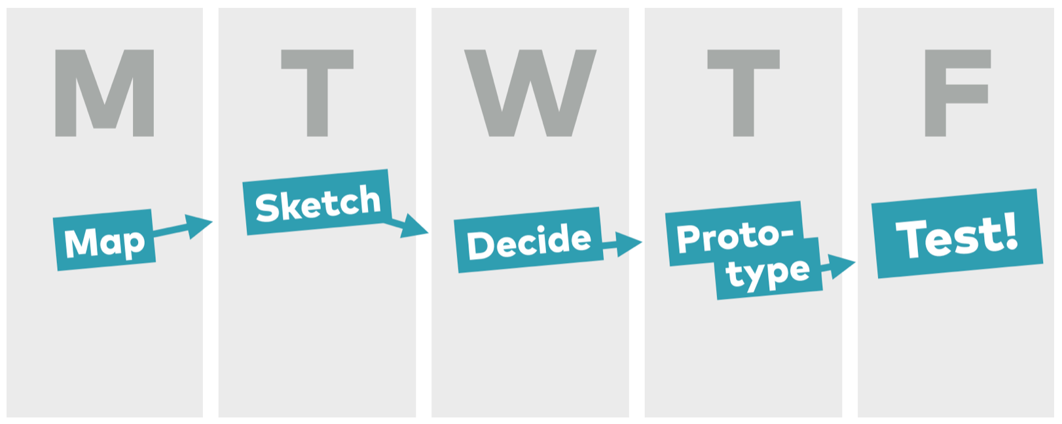
The Sprint

Slide 6
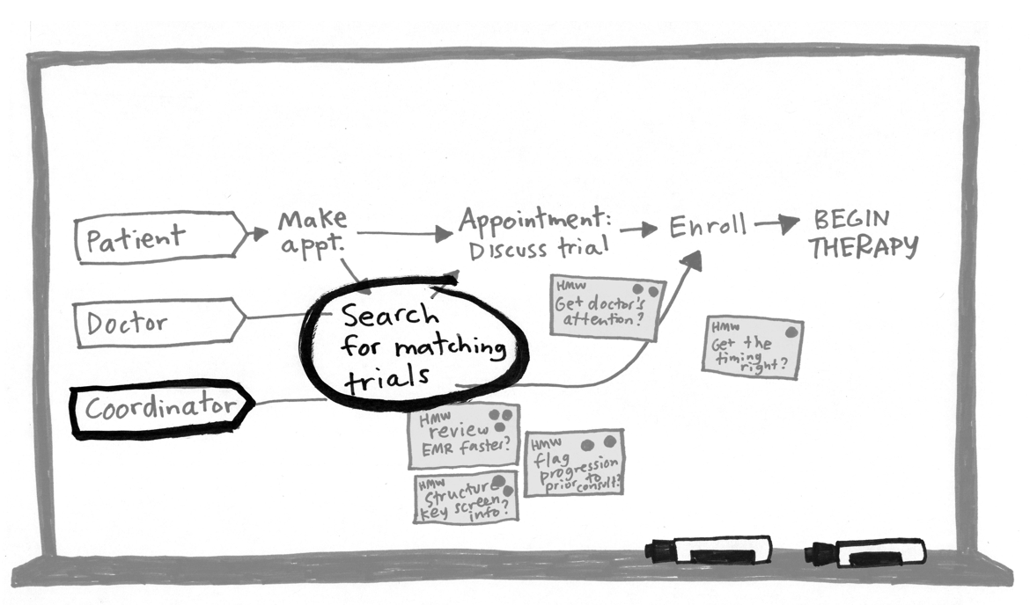
Monday - Map
Notes:
Builds the foundation and focus for the sprint week
A journey uncovers opportunities by mapping out the user or customer experience
Create user journeys - Create a positive journey roughly 5-15 steps long
Start with - Who is the target client / user?
When does the customer experience begin?
What is the goal we are trying to reach?
How might we - Rephrase questions or assumptions you might have for your user journey
Think of ideas or opportunities of how your team might create opportunities
One HMW per sticky note
Then you vote on the best ideas

Slide 7
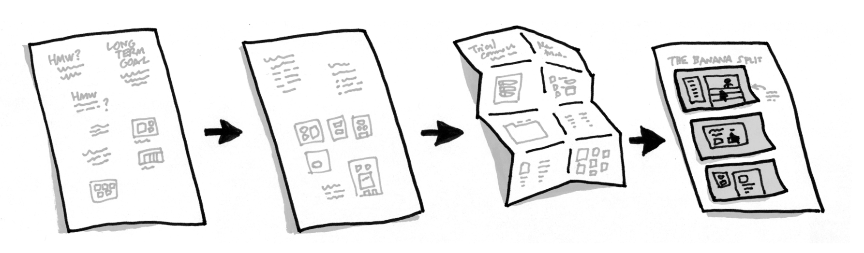
Tuesday - Sketch
Notes:
All about solving the problem using deep thinking. Group brainstorms don’t work, so you’ll sketch alone.
Crazy 8’s – generate a variety of solutions quickly. Sketch 8 distinct ideas in 8 minutes.
Use idea’s from your crazy 8’s and create a storyboard not the app screen designs alone but the users entire journey– 12 minutes

Slide 8
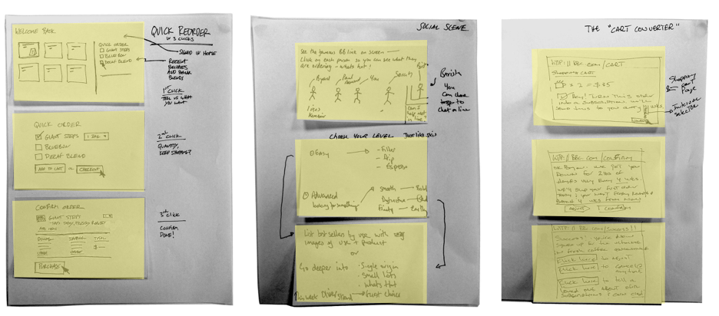
Wednesday - Decide
Notes:
To decide which are the best storyboards, each person will explain theirs to their team. Then you will each vote for your favourite in silences so that you avoid group think. The decider will choose which are the best 3 sketches and turn it into a new storyboard
Discuss storyboards – 15 minutes
Vote for your favourite storyboard – 1 sticker each
The decider chooses the best 3 out of the storyboards with stickers

Slide 9
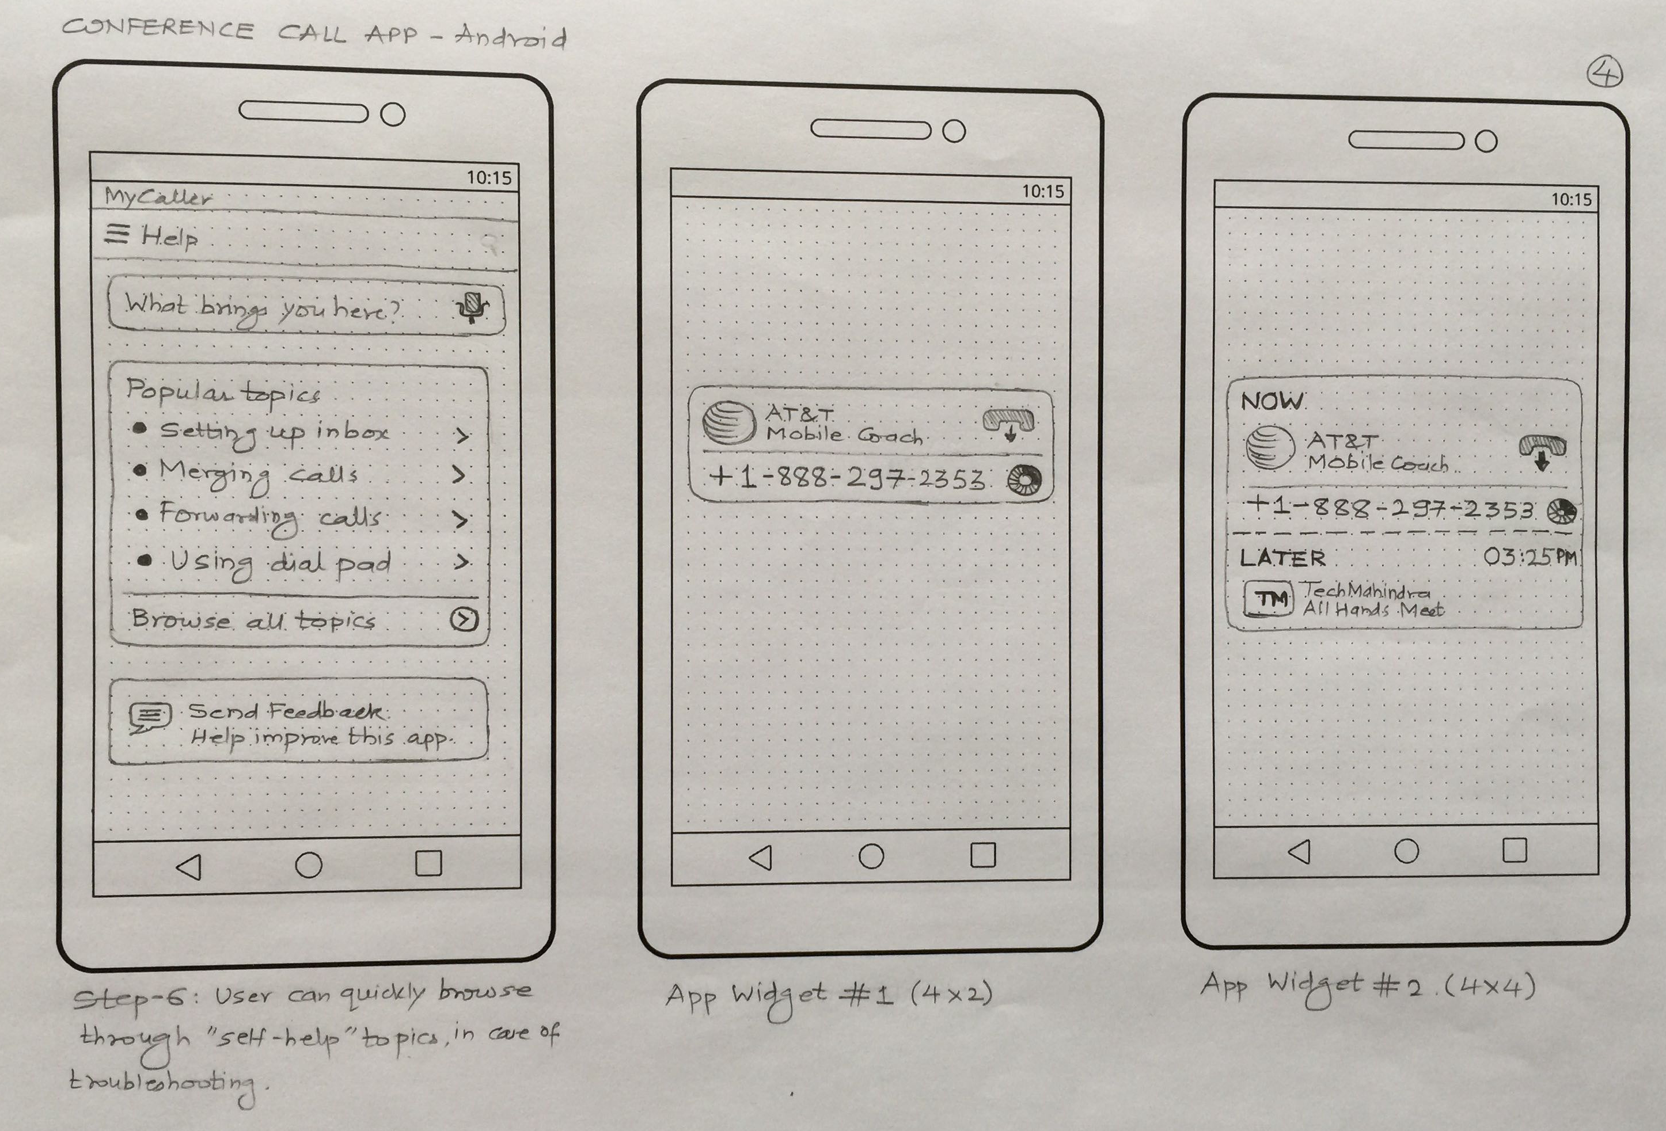

Thursday - Prototype
Notes:
Create a realistic view of the app which you can use to get feedback from customers from the chosen storyboards. Create a single prototype as a team, the decider can select someone to draw out the ideas
Paper prototype using the 4 frames provided (this is the app journey)

Slide 10
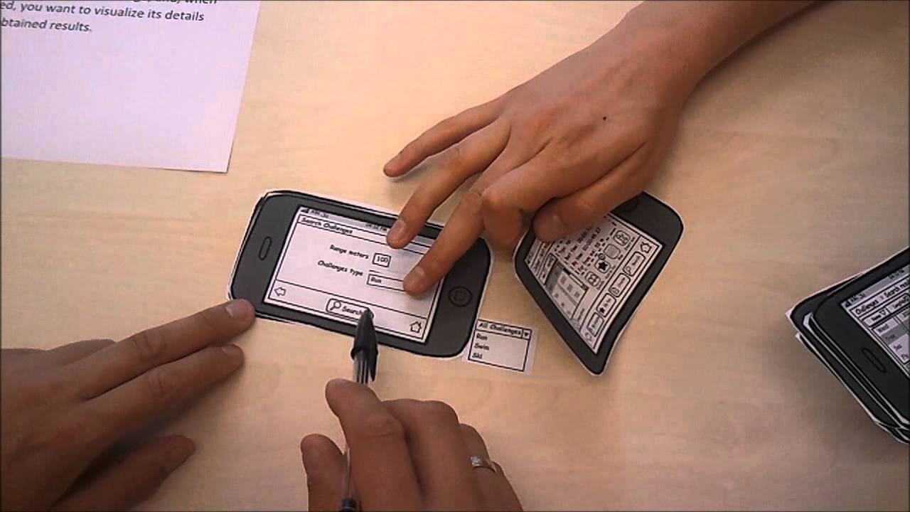
Friday - Test
Notes:
Each decider swaps and tests with another group, the remaining team members observe.
Example interview questions:
Can you please take me through what you see here?
Why do you think that?
How would you improve this process?

Slide 11
The End.
Please mingle and look at what the other teams did…do you have any questions or anything to share with the group?

